Slide 1
Predicting Alcohol Sales in the Great State of Iowa

Slide 2
Initial Analysis
Total sale of alcohol for all counties in 2015 approximately $28,527,245
Iowa counties in total sold approximately $6,291,870 for the first three months of 2016, more than the $6,153,795.89 they sold in Jan-March 2015.
What factors will allow 2016 to continue to do better than 2015?
Used a dataset of 10% of the total sales

Slide 3
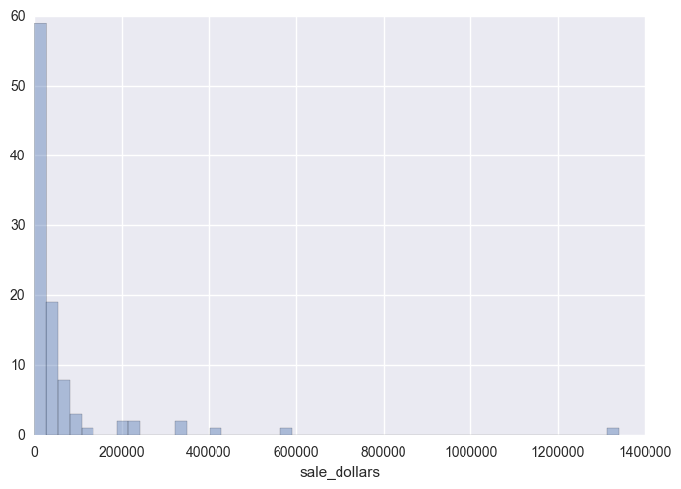
Notes:
Total sales by county for the first three months of 2015.
The outlying highest counties most likely include Polk, Linn, Scott, Black Hawk, Dubuque, Pottawattamie, Johnson, and Woodbury, which had the most transactions of all the counties (found this through plotting the mean sales for each county in each year’s aggregation.

Slide 4
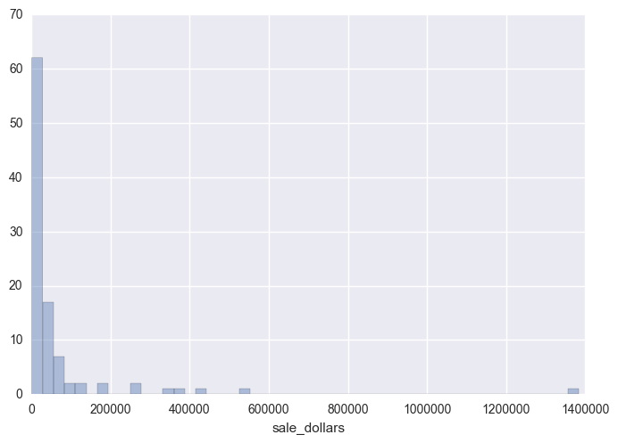
Notes:
Total sales by county for the first three months of 2016.

Slide 5
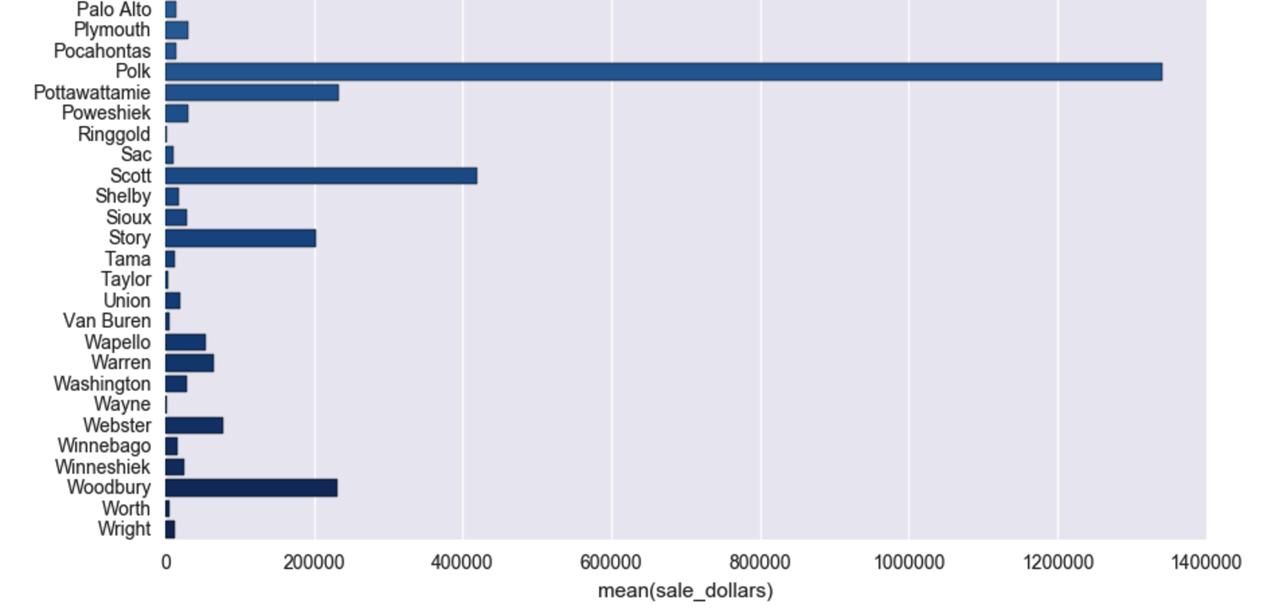
Notes:
Method shared with me by my colleague Phil Brad, showcasing mean sales in each county.

Slide 6
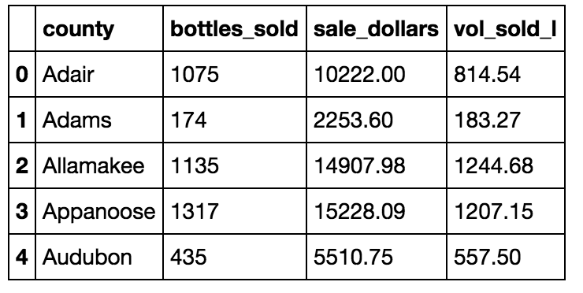
Finding a predictive model for total sales
Notes:
2015 df in which I aggregated the values by sum and ordered by each county.
Method for aggregation shown to me by my colleague
Couldn’t use retail price using this method, as the aggregate of that wouldn’t be informative. Next I should

Slide 7
Linear Regressions
Testing on January March 2015 sales data
Used “LinearRegression” method from scikit-learn to find what factors, like bottles sold or volume liters sold, would have the largest effect on sales
Tested with different variables, switching in and out “volumes sold” and “bottles sold”
Used “Train-Test-Split” method to test on dataset
Notes:
Which is more predictive for sales? Bottles sold or vol sold liters?
Accounted for counties with get_dummies

Slide 8
Results
Testing for just volumes sold and counties, found a linear regression score of 0.935 (out of 1)—indicates testing by volume sold is highly predictive
Testing for just bottles sold and counties, found a linear regression score of 0.813—indicates testing by bottles sold is very predictive, but significantly less so than volumes sold.
Notes:
However, bottles being less predictive may be simply due to the different measurements and aggregates of these variables. Nevertheless, it is an interesting finding.

Slide 9
Results Contd.
Tested model on 2016
Found volumes sold to be far LESS predictive of sales than in 2015, with a linear regression score of 0.463.
In this case, bottles sold was much more predictive of sales, with a score of 0.886.

Slide 10
Bias vs. Variance?
Testing for volumes sold for sale dollars worked in the first three months 2015, but does not apply well to the first three months of 2016
Perhaps overfitting the liters sold feature resulted in a high error in the model due to variance
Will need to to find different outside features to predict sales

Slide 11
Next Steps and Reflection
Find the discrepancies between volumes sold and bottles sold in 2015 and 2016
Perhaps I should have included the averages of state bottle retail and bottle cost as variables, and organized them by county
Investigate categories of alcoholic beverages and group them by type and volume to see if they have an effect on sale numbers
Find outside features

